Slide 1

Functional Annotation Jamboree
Phoenix Bioinformatics
Tanya Berardini, Monica Munoz-Torres, Leonore Reiser PAG XXVI San Diego, CA 16-Jan-2018

Slide 2

Tonight’s plan
Primer on Annotation
Joint Group Exercise 1
Joint Group Exercise 2
Individual/Partner Exercise 3 (time permitting)

Slide 3
Primer on Annotation
Overview
Functional Annotation
Controlled Vocabularies
Applications
Notes:
Overview (Tanya)
Who are we?
What is biocuration?
Functional Annotation (Leonore)
Controlled Vocabulary Annotation(Leonore)
What is a controlled vocabulary (CV) annotation?\
What is an ontology?
GOAT basics
ORCID to login
Play with tool (5 mins)
Applications/Why CV annotations are great (Moni)
Term enrichment
Cross-species queries
Computable representation of biology

Slide 4
Who are we?
PhDs in biological sciences
Tanya Berardini: annotation of gene function, development of controlled vocabularies, community support and engagement
Moni Munoz-Torres: genome curation, structural annotation, curation software development
Leonore Reiser: gene function annotation, genome data curation

Slide 5
Phoenix Bioinformatics
Non-profit organization founded in 2013
Mission:
integrate, organize, and share data
promote data resource sustainability
foster interaction and collaboration among scientists

Slide 6
Goals
Education (on biocuration)
Collaboration (with fellow scientists)
Contribution (to the body of integrated, computable knowledge)
Fun!

Slide 7
What is biocuration?
The collection, annotation, and validation of knowledge disseminated through biological databases.
Areas: gene and protein structure, gene function, allele, phenotype, sequence variation, nomenclature, etc.
Notes:
collects, annotates, and validates information that is disseminated by biological (https://en.wikipedia.org/wiki/Biology) and model Organism Databases (https://en.wikipedia.org/wiki/Model_Organism_Database).

Slide 8
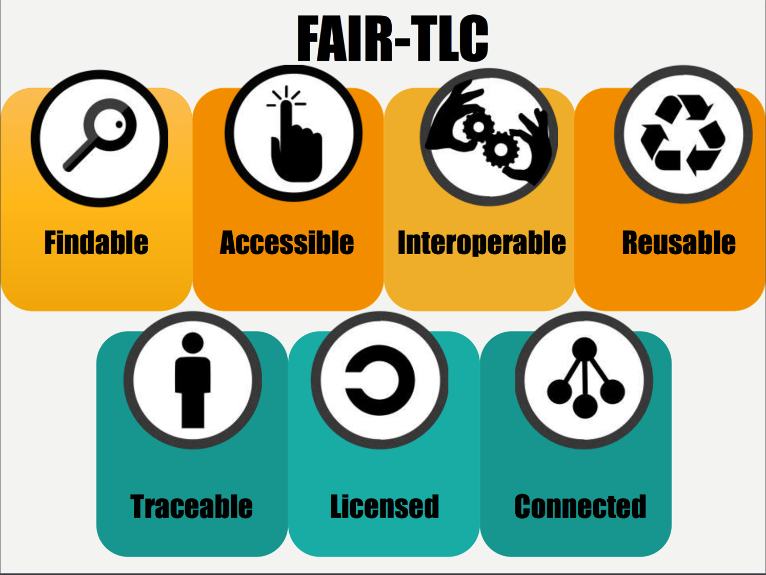
Credit: Melissa Haendel

Slide 9
Primer on Annotation
Overview
Functional Annotation
Controlled Vocabularies
Applications

Slide 10
Functional Annotation
Gene summary
Gene nomenclature
Biological ontologies
Function/process/subcellular component
Anatomy/developmental stages
Alleles
Phenotypes

Slide 11
Functional Annotation
Assembly:
Genome
Transcriptome
Predicted DNA / Protein Sequences
Examples:
InterProScan
PANTHER Term Enrichment Tool
TAIR, powered by PANTHER
Compare against databases
Relying solely on sequence similarity
Build protein and domain profiles, then run sequence similarity analysis
Enrichment analysis (expression data)
Functional assignments
Gene Ontology, Uberon anatomy (or stage) Ontology, Chemical Entities of Biological Interest, Kyoto Encyclopedia of Genes and Genomes (KEGG), OrthoDB, Benchmarking Universal Single-Copy Orthologs (BUSCO), etc.

Slide 12
Primer on Annotation
Overview
Functional Annotation
Controlled Vocabularies
Applications

Slide 13
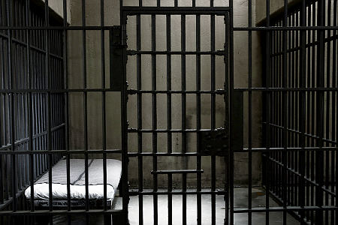
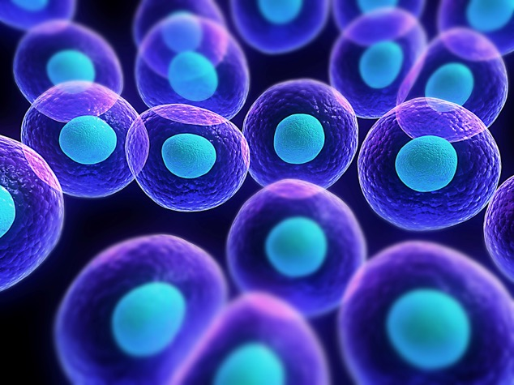
Language inconsistencies in biology
The same name for two different concepts
Cell
or

Slide 14
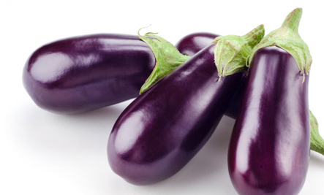
Language inconsistencies in biology
Two or more different names for the same concept
Eggplant
Brinjal
Aubergine
Melongene
The same is true for biological concepts:
This makes comparisons difficult, specially when comparing across species or databases.

Slide 15
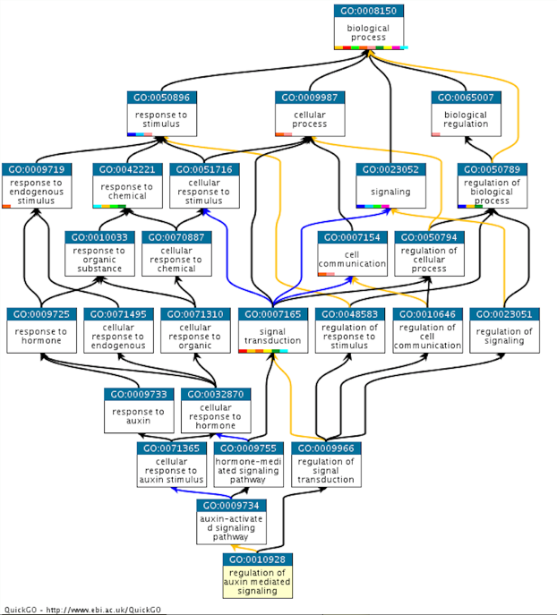
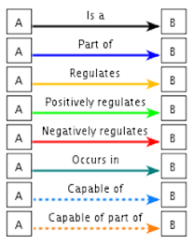

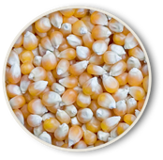
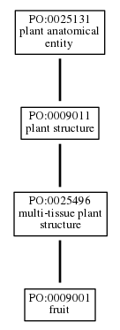
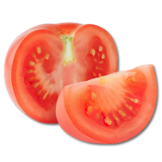
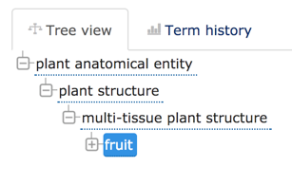

Ontology
An ontology is a set of organized concepts and their relationship to each other; ontologies are usually limited to specific knowledge domains.
Plant Ontology
Gene Ontology
Notes:
Define ontology
-hierarchy (Simple tree vs very DAGGY tree)- EBI view / AmiGO view
Point is that ontologies capture more than just vocabulary, there are relationships that accurately reflect biological knowledge and empower search and analytics.

Slide 16
Ontology Annotations
These are not ‘attached keywords.’
These annotations are an assertion about a gene product (in this case) that is supported by traceable evidence.
Object (e.g. protein)
NOG1
Attribute
(ontology term)
Root
Evidence
RNA seq evidence
Reference
PMID: 28835689

Slide 17
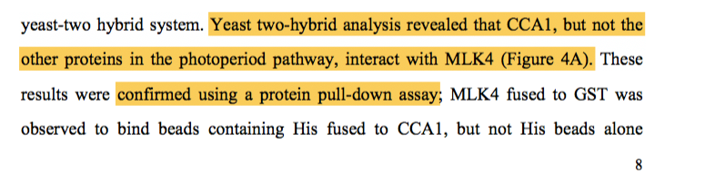
Example
A GO annotation is a statement that a gene product:
has a particular molecular function or is involved in a particular biological process or is located within a certain cellular component
as determined by a particular method
as described in a particular reference

Slide 18
General Term Guidelines for Annotation
Choose the most granular term; make use of the awesome power of ontologies and inheritance.
For process try to identify term that represents the most core function or process (e.g. vesicle transport) even though many more downstream or even global processes may be affected
For component, that could be down to the macromolecular complex
For anatomy- same, if the tissue specific location is more precise, use that (e.g. ovary wall vs fruit)
Choose terms that represent the function not phenotype (i.e. defense response to pathogen is legit, disease resistance is not).
If a term seems to be missing- we can add it. Ontologies are like living things that grow and change as our understanding does.
Notes:
Functionally for TAIR we focus on getting annotations and not necessarily comprehensively curating a paper. So we may select ONE experiment vs multiple lines of evidence in support of say subcellular localization. We do not involke any ’additional’ peer review, we will assume that the expert reviewers have done their jobs.

Slide 19


GO Evidence Codes
Inferred from Sequence or structural Similarity (ISS)
Inferred from Sequence Orthology (ISO)
Inferred from Sequence Alignment (ISA)
Inferred from Sequence Model (ISM)
Inferred from Genomic Context (IGC)
Inferred from Biological aspect of Ancestor (IBD)
Inferred from Key Residues (IKR)
Inferred from Rapid Divergence (IRD)
Inferred from Reviewed Computational Analysis (RCA)
Traceable Author Statement (TAS)
Non-traceable Author Statement (NAS)
Inferred by Curator (IC)
No Biological Data available (NBD)
Inferred from Direct Assay (IDA)
Inferred from Physical Interaction (IPI)
Inferred from Mutant Phenotype (IMP)
Inferred from Genetic Interaction (IGI)
Inferred from Expression Pattern (IEP)
http://geneontology.org/page/guide-go-evidence-codes
Notes:
Evidence codes and evidence hierarchy. 3 broad categories 1) Computational Evidence Codes ,2) Author/Curator Statements and 3) Experimental Evidence Codes which are the ones we will primarily be using here.

Slide 20
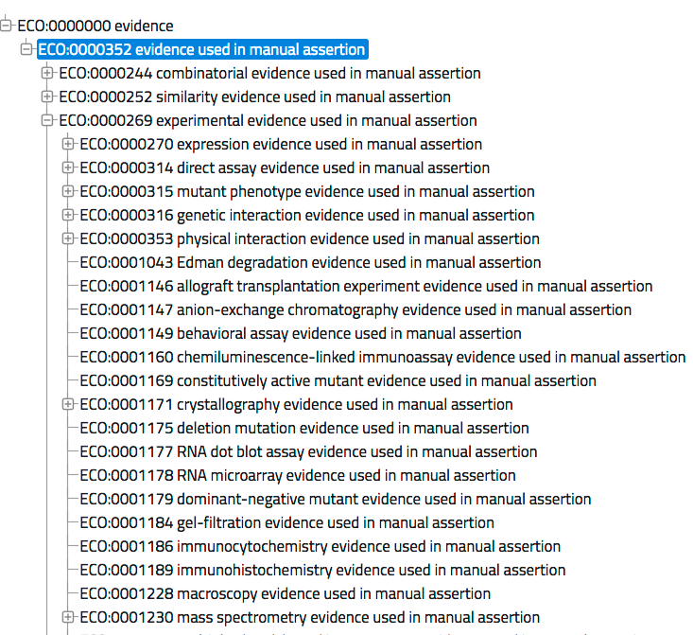

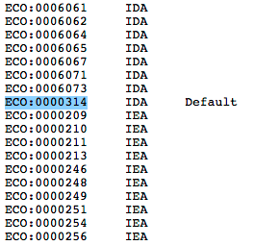
Evidence Code Ontology
https://raw.githubusercontent.com/evidenceontology/evidenceontology/ master/gaf-eco-mapping-derived.txt
http://www.evidenceontology.org/
Notes:
Yes there is an ontology for that. GOAT and Noctua use Evidence Code Ontology Terms which actually map to GO 3 letter codes

Slide 21
Primer on Annotation
Overview
Functional Annotation
Controlled Vocabularies
Applications

Slide 22
Applications
“Term enrichment”
Cross-species queries
Computable representation of biology

Slide 23
Functional Annotation Classification, enrichment, over/under-representation
List of genes/proteins with associated functional classification from a database: Gene Ontology, PANTHER Protein Class, Reactome Pathway, OrthoDB, KEGG, etc.
A list of genes/proteins is compared to a reference list to statistically determine over- or under-representation of the selected ontology categories among genes/proteins in the list.
Enrichment: A list of genes/proteins with expression data (gene expression, protein expression, etc.), is evaluated to assess likelihood that numerical values of genes associated with a particular ontology term were drawn randomly from the overall distribution of values.

Slide 24
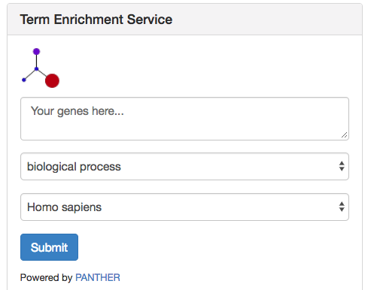

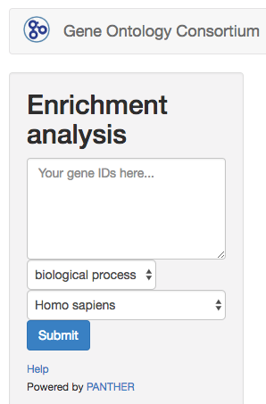
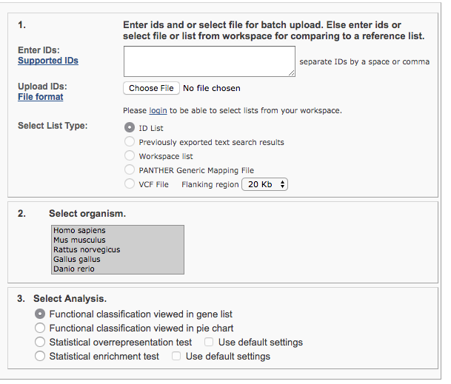

Term Enrichment
For MODs
http://geneontology.org/page/go-enrichment-analysis
Ontology
Species
http://amigo.geneontology.org/
Powered by
http://www.pantherdb.org/
http://GeneOntology.org/

Slide 25
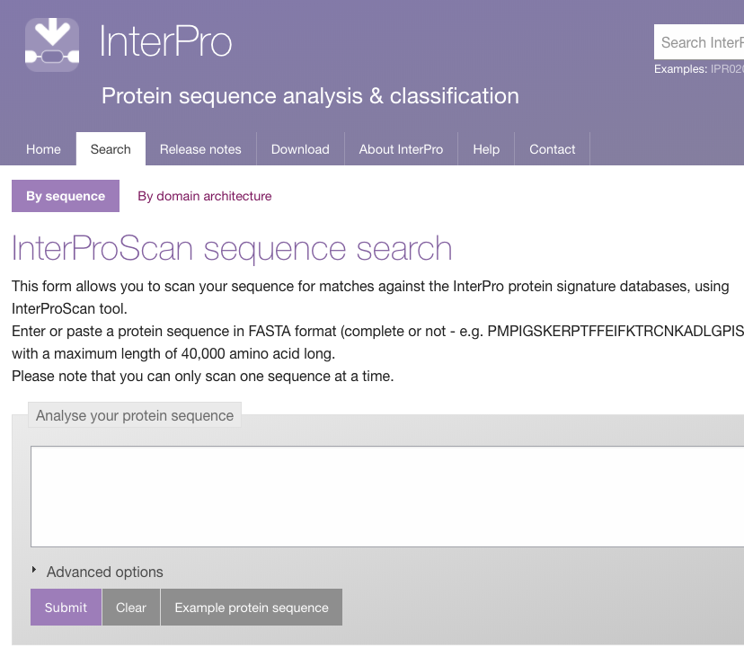

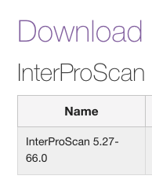
Functional Assignment by Sequence Similarity in the context of evolution
MODs & no-MODs
InterProScan
Predicts GO terms based on detected domains using a mapping file, InterPro-2-GO, one sequence at a time.
http://geneontology.org/page/download-mappings
http://www.ebi.ac.uk/interpro/search/sequence-search

Slide 26
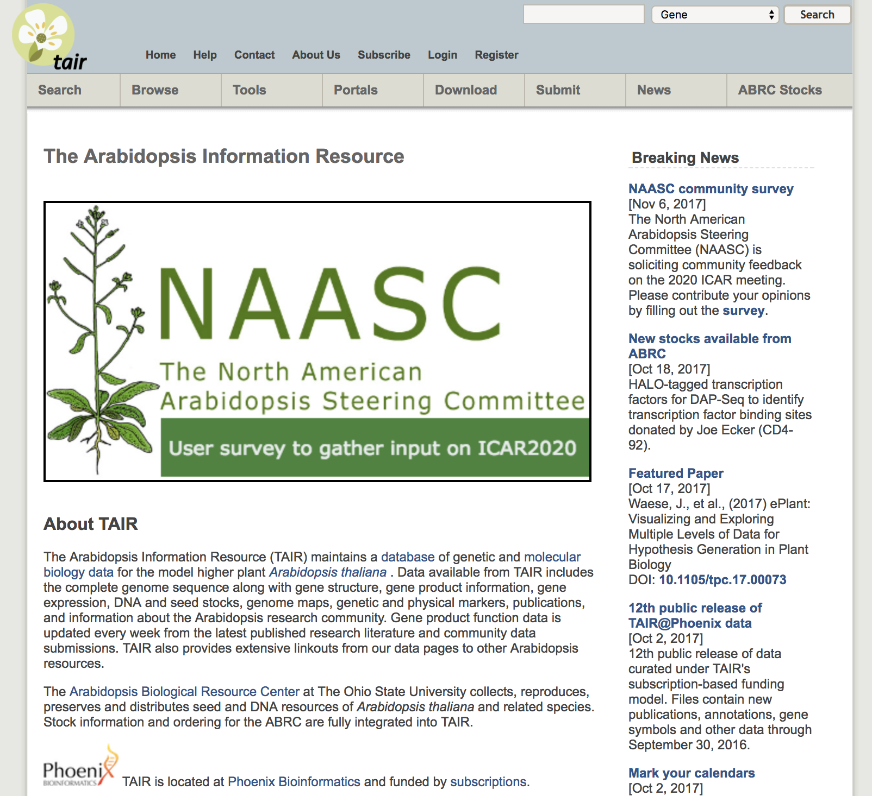


Term Enrichment at The Arabidopsis Information Resource (TAIR)
Powered by
http://www.pantherdb.org/
https://www.arabidopsis.org

Slide 27
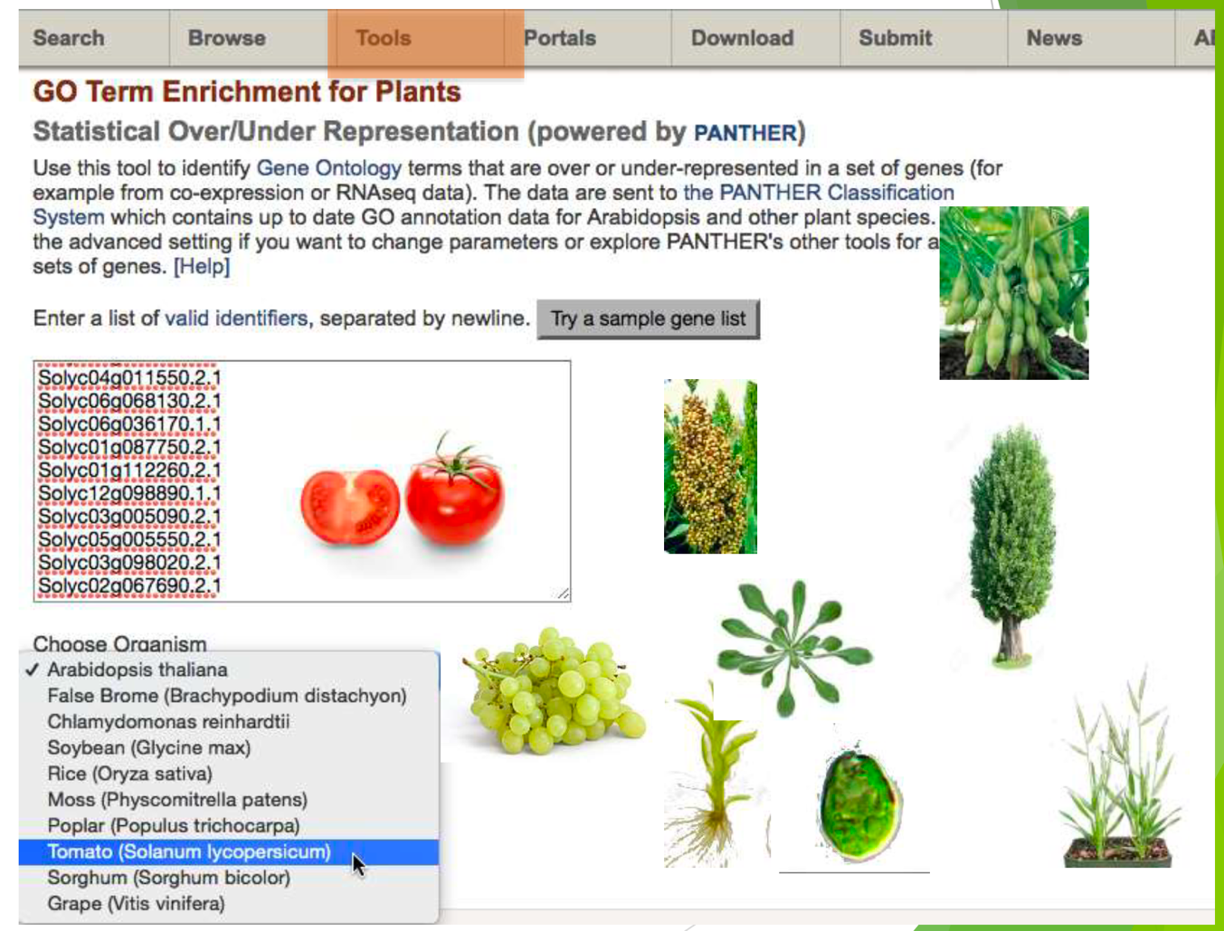

Identify terms over or under-represented in a set of genes: “in this list of genes, are there any functional classes that are found more often than expected when compared with the
reference list?”
https://www.arabidopsis.org
Powered by
http://www.pantherdb.org/

Slide 28
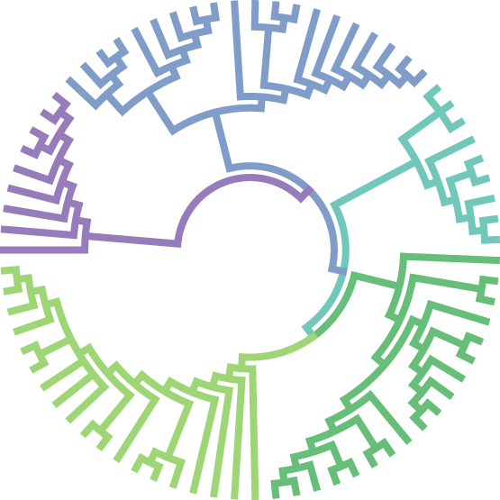
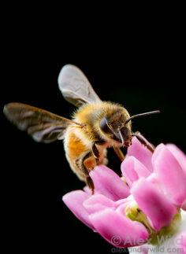
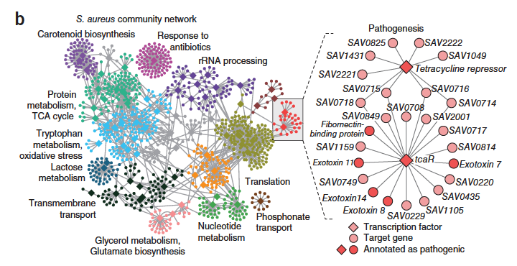
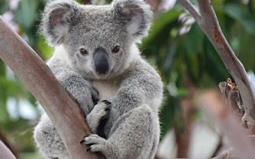
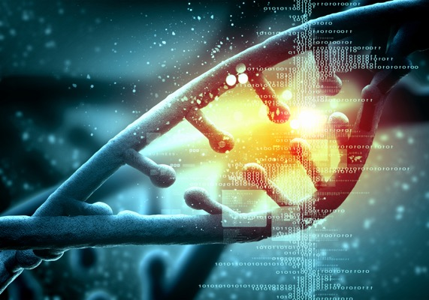
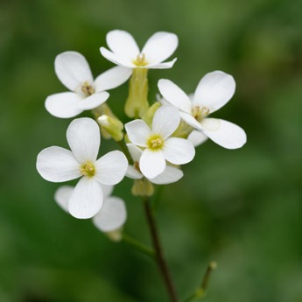
Comparing knowledge across species

Slide 29
Training Materials
Articles for annotation exercises and slides from this presentation can be found at:
http://bit.ly/phoenix-pag-2018

Slide 30

Any article with PMID/DOI
(Any) gene product
UniprotIDs for protein-coding genes
RNACentral IDs for non-coding RNAs
(AGI identifiers can be used for A. thaliana genes)
Notes:
GOAT- LeonoreGeneric Online Annotation ToolDesigned to capture gene function information in the form of GO and PO annotations, gene names and summary data.

Slide 31
Let’s play with GOAT
Currently under development as a student project with SE students from Rochester Institute of Technology (RIT).
Gene nomenclature
Gene summaries
GO and PO annotations
http://toastdos.phoenixbioinformatics.org/
Use your ORCiD; register for one at https://orcid.org/
Notes:
GOAT is a tool under development to facilitate functional annotation of Gene Products using ontologies

Slide 32
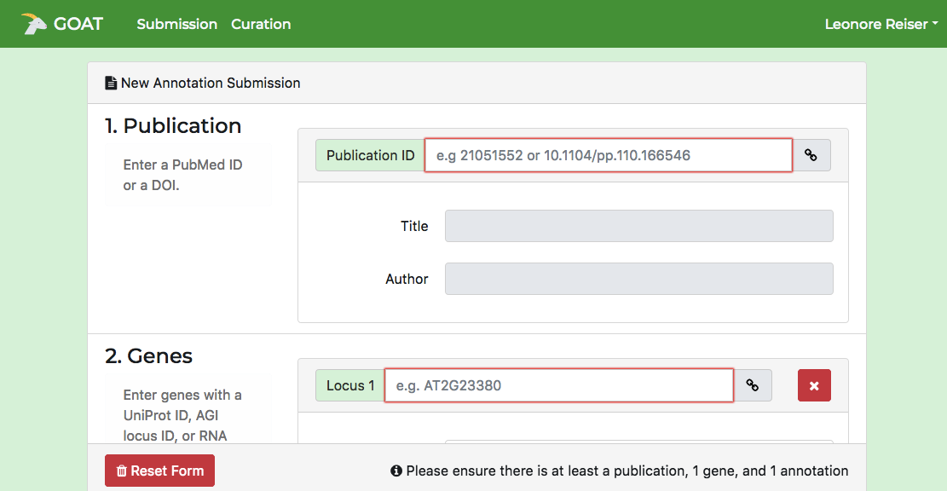
Entering publication data into GOAT

Slide 33
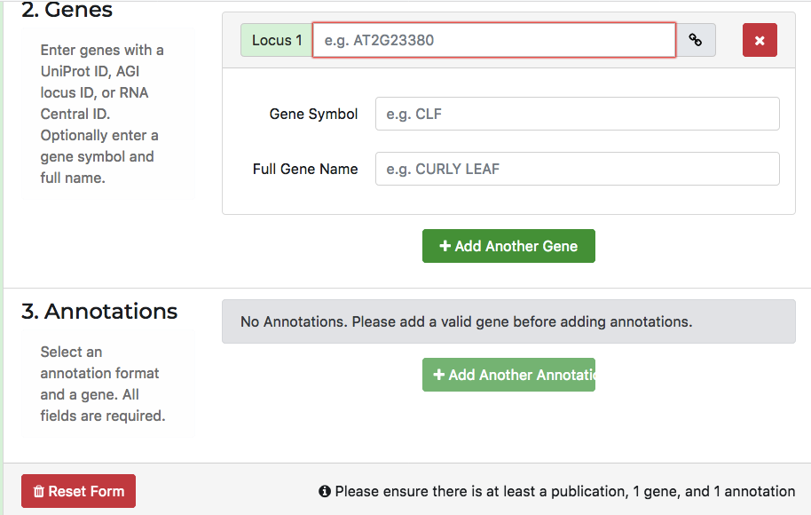
Entering gene information in GOAT

Slide 34
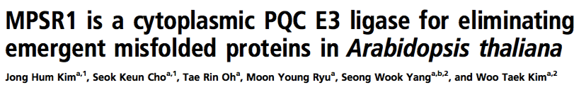
Exercise 1
www.pnas.org/cgi/doi/10.1073/pnas.1713574114
Based on the title we can assume that the paper includes experiments that demonstrate function (E3 ligase), process (something about eliminating misfolded proteins) and localization (cytoplasm).
Notes:
possible paper(s):MPSR1 is a cytoplasmic PQC E3 ligase for eliminating emergent misfolded proteins in Arabidopsis thaliana (doi.org/10.1073/pnas.1713574114)
Biochemistry paper, easy, function, process, component, all pick the same term
Figure or table (capturing data points)
Highlight relevant information to extract
How do we put this information into GOAT? Show the association across gene to terms, etc.
If paper has been curated, show the final result in TAIR, AmiGO, etc.

Slide 35
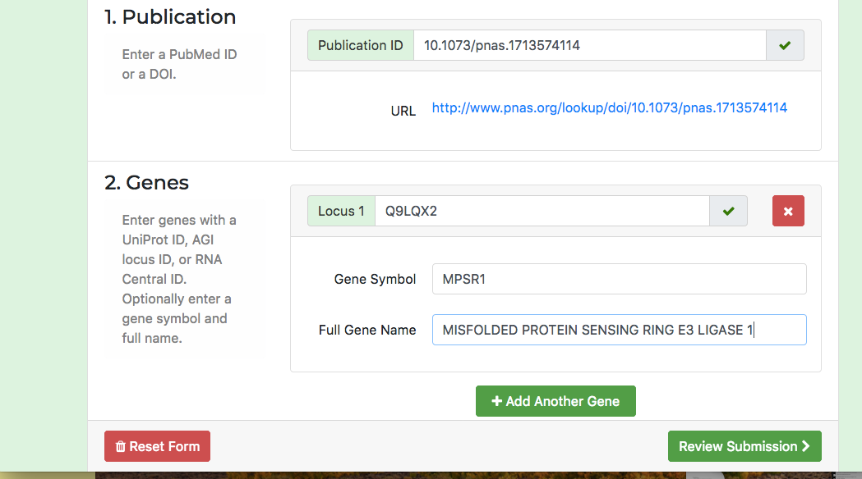
First add the article and gene information
Info to verify this is the correct paper
Add all the genes from the article that you will annotate
Notes:
Enter the DOI and there will be validation step that includes a link to the article to verifiy
Add the UniProt or AGI locus ID and it will validate.

Slide 36
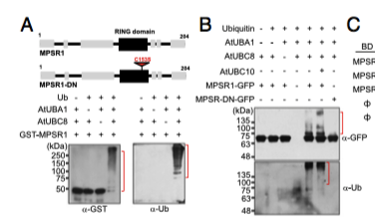
Molecular Function/Biological Role Assay- Fig 2
Based on this figure/experiment: What can we say about the function of MPSR1, aka At1g26800 (AGI Identifier) or Q9LQX2 (UniProt ID)?
Notes:
Ubiquitin Ligase is a molecular activity- that is capable of performing this process of ubiquitination

Slide 37
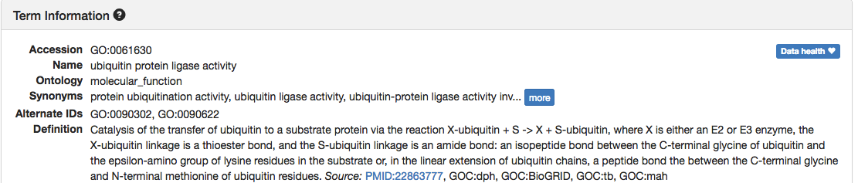

Molecular Function/Biological Role Assay- Fig 2
Notes:
Ubiquitin Ligase is a molecular activity- what would be the evidence code?

Slide 38
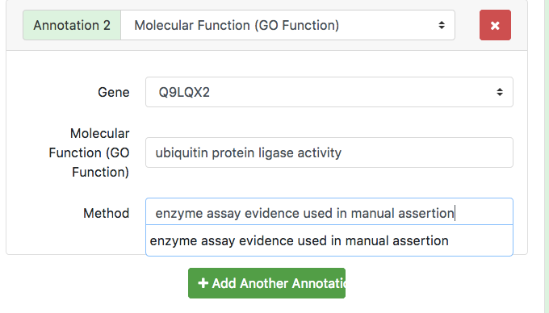
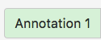
Adding Molecular Function
Click to add more annotations…

Slide 39
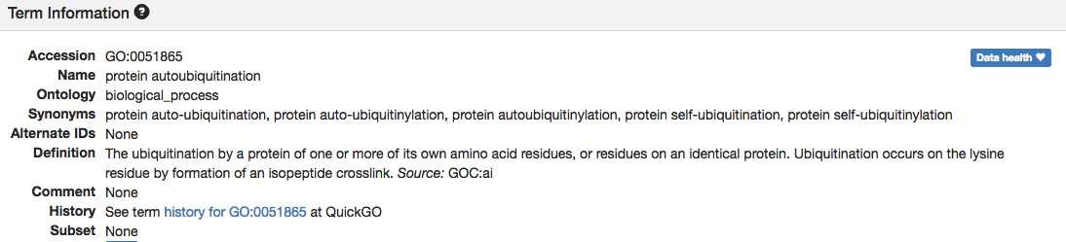
Molecular Function/Biological Role Assay- Fig 2
Notes:
Ubiquitin Ligase is a molecular activity- that is capable of performing this process of ubiquitination

Slide 40
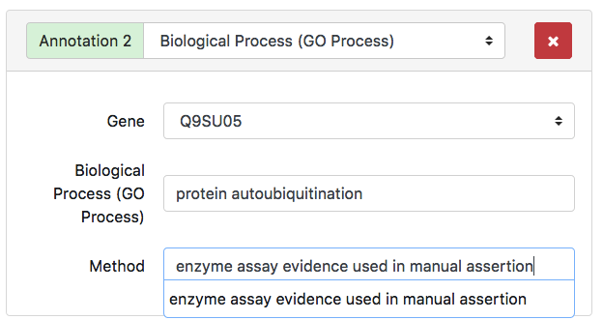
Biological Process

Slide 41
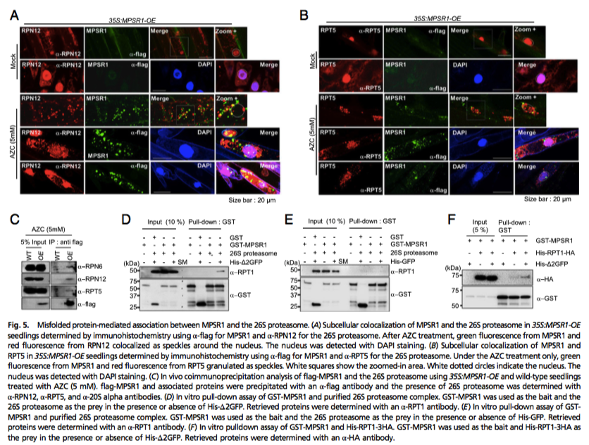
Subcellular Localization Assay –Fig 5

Slide 42
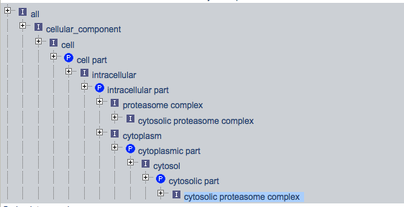
Subcellular Localization Assay –Fig 5
most granular…

Slide 43
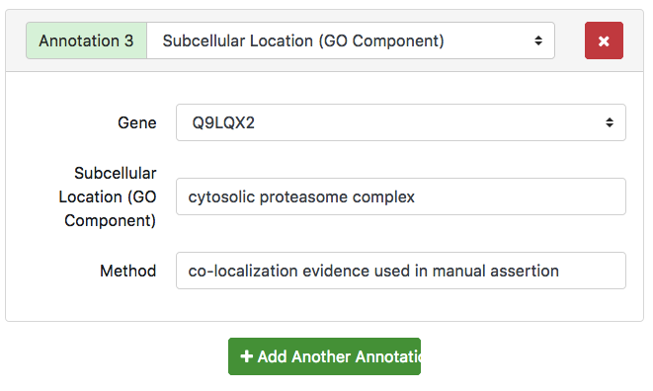
Subcellular Localization Assay –Fig 5

Slide 44
Exercise 2
Paper with some IGI data (double mutant), figure with interacting genes
People work independently on their own for 5-7 mins, discuss results
Now that you know the steps, go through it yourself and decide most appropriate term.
Notes:
Article for this exercise (has IGI, and IPI annotations): The F-box Protein KIB1 Mediates Brassinosteroid-Induced Inactivation and Degradation of GSK3-like Kinases in Arabidopsis (10.1016/j.molcel.2017.05.012)

Slide 45
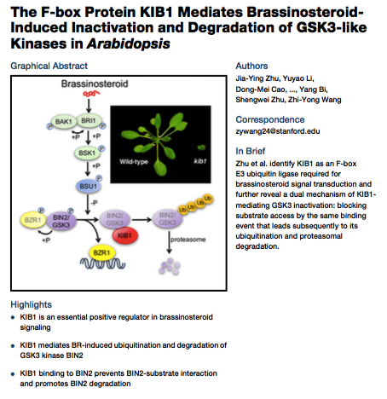
Notes:
Example paper2. Nice summary right in front- pretty much tells us what we are going to be able to curate from the paper ;)BR

Slide 46
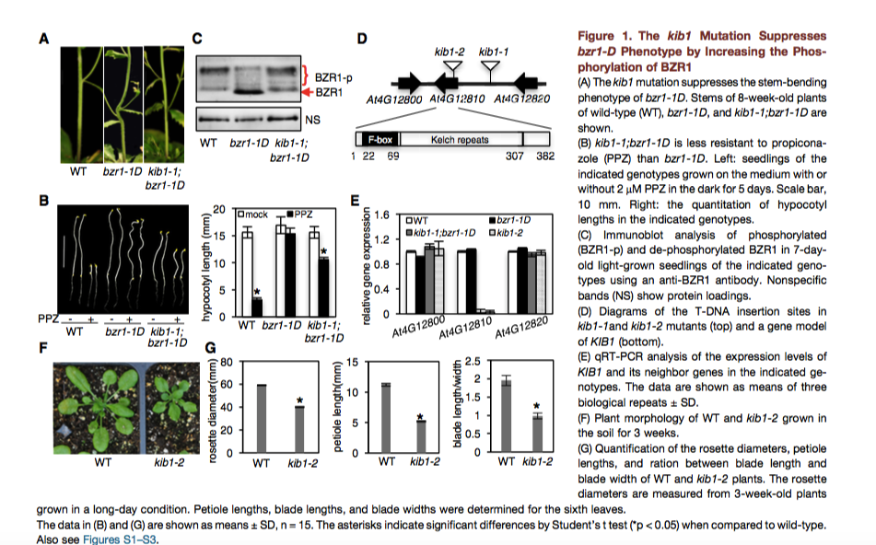
Case Study: Process inference based on genetic interaction (IGI)
Notes:
Figure 1. Experiment designed to identify suppressors of bzr1-D a dominant mutation of a brassinosteroid induced transcription factor that results in a constitutive BZ phenotype. Suppressor is expected to affect the phosphorylation of BZR1 (BZR1-PP is not nuclear localized and therefore ‘inactive’ form). So what can we say about the function of KIB1 (relative to the bzr1-D mutation), if it regulates transcriptional effector mediating output from the BZ signal?

Slide 47
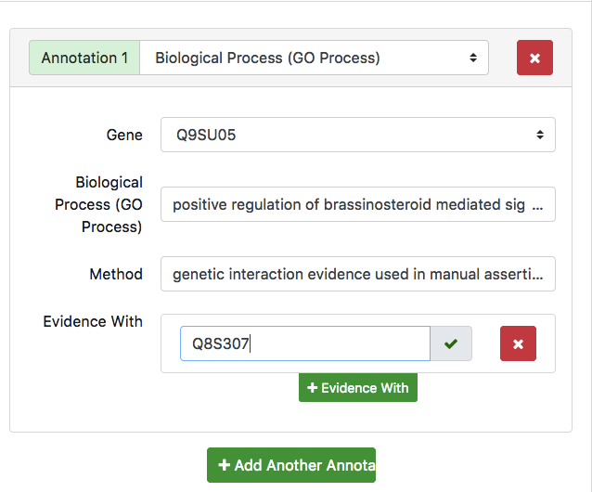
Case Study: Process inference based on genetic interaction (IGI)
other mutated gene
even more …
Notes:
Figure 1. Experiment designed to identify suppressors of bzr1-D a dominant mutation of a brassinosteroid induced transcription factor that results in a constitutive BZ phenotype. Suppressor is expected to affect the phosphorylation of BZR1 (BZR1-PP is not nuclear localized and therefore ‘inactive’ form). So what can we say about the function of KIB1 (relative to the bzr1-D mutation), if it regulates transcriptional effector mediating output from the BZ signal?

Slide 48
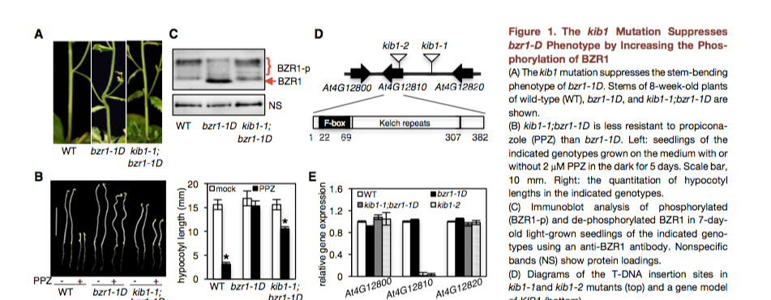
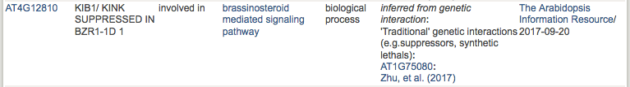
Case Study: Process inference based on genetic interaction (IGI)
IGI annotations require specification of the interacting partner
Notes:
Figure 1. Experiment designed to identify suppressors of bzr1-D a dominant mutation of a brassinosteroid induced transcription factor that results in a constitutive BZ phenotype. Suppressor is expected to affect the phosphorylation of BZR1 (BZR1-PP is not nuclear localized and therefore ‘inactive’ form). So what can we say about the function of KIB1 (relative to the bzr1-D mutation), if it regulates transcriptional effector mediating output from the BZ signal?

Slide 49
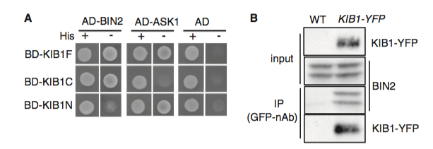
Case Study: How GO treats protein-protein interactions
Ca
Notes:
Figure 4. Codifying protein-protein interactions. Here we have a figure that demonstrates a physical interaction between two proteins. KIB1 and BIN2, also ASK1. How do we codify this relation in GO? Via the protein binding molecular function annotation. How do we annotate figure 4A.

Slide 50
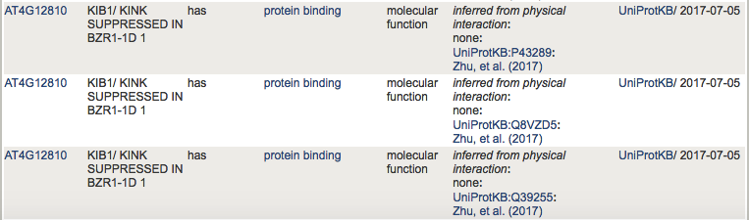
Case Study: How GO treats protein-protein interactions
Ca
Notes:
Figure 4. Codifying protein-protein interactions. Here we have a figure that demonstrates a physical interaction between two proteins. KIB1 and BIN2, also ASK1. How do we codify this relation in GO? Via the protein binding molecular function annotation. How do we annotate figure 4A.

Slide 51
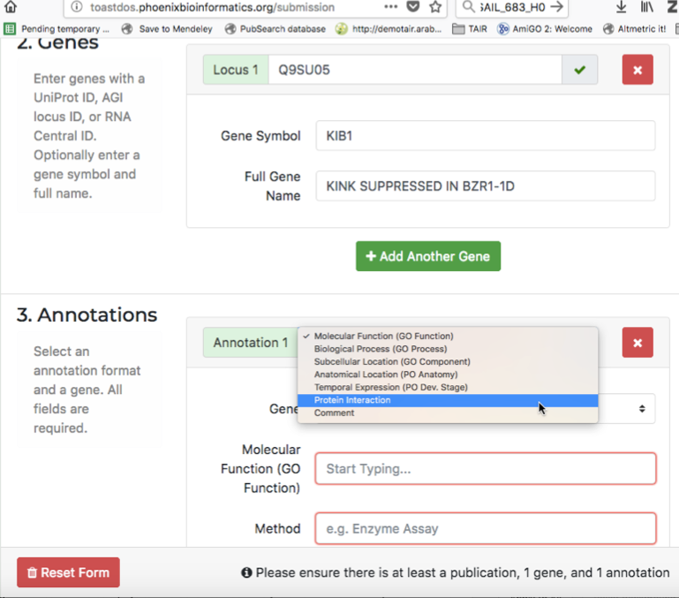
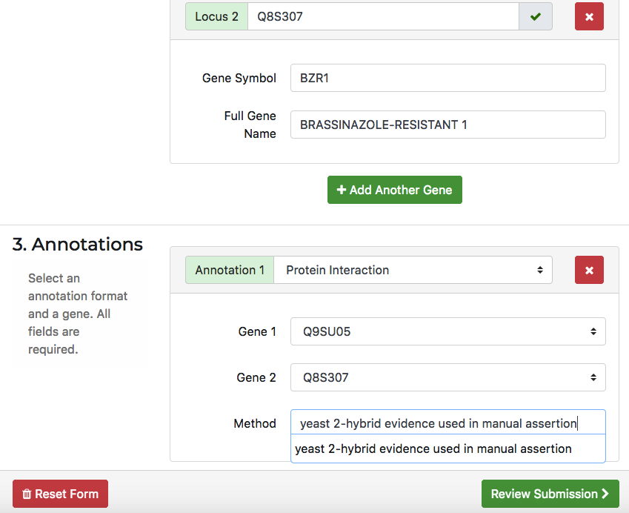
Case Study: How GO treats protein-protein interactions
Notes:
Figure 4. Codifying protein-protein interactions. Here we have a figure that demonstrates a physical interaction between two proteins. KIB1 and BIN2, also ASK1. How do we codify this relation in GO? Via the protein binding molecular function annotation. How do we annotate figure 4A.

Slide 52
Exercise 3
Assigned papers with guidance
Bring your own paper
Phoenix staff to help as needed

Slide 53
To Keep in Mind
When making functional annotations for genes
Choose primary research articles, not reviews
Verify experimental design, organism, and results
Find the identifier for the gene(s) in question in the paper
Look at the results section, aim for the figures and tables
Use the most granular terms possible
Notes:
What to look for in a paper? What makes a paper *good* for functional curation?…… e.g. understanding if / when to annotate phenotypesNOT high throughput papers!

Slide 54
To Keep in Mind
When writing papers
Clearly identify organism(s) and gene identifiers
Use existing gene nomenclature, otherwise check with your species database on naming conventions
Identify versions of bioinformatics tools used as well as the versions of the data used in the analysis, if this applies
Verify information in reference databases- contact someone if there are errors/omissions
Notes:
What to look for in a paper? What makes a paper *good* for functional curation?…… e.g. understanding if / when to annotate phenotypesNOT high throughput papers!

Slide 55
Training Materials
Articles for annotation exercises and slides from this presentation can be found at:
http://bit.ly/phoenix-pag-2018

Slide 56
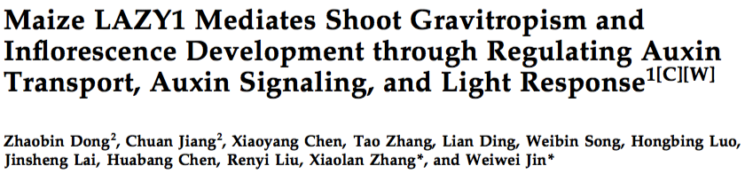
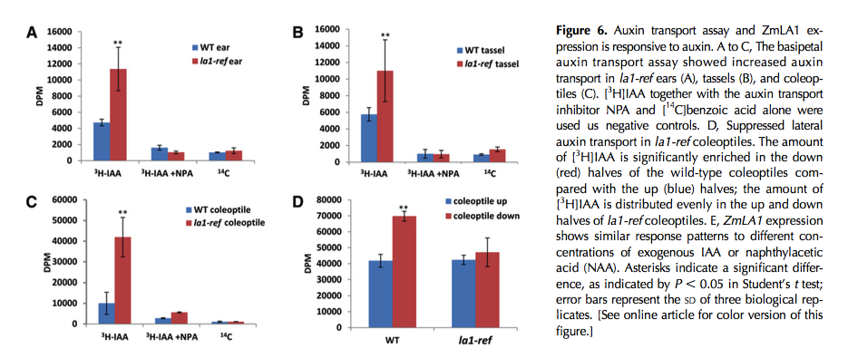
What evidence code applies here?
Notes:
Example to use to clarify between using IDA and IMP. The key thing here is that they are comparing transport in wild type and mutants. Not assessing the WT gene product directly so the appropriate evidence code is IMP. We use ECO to enrich the meaning.

